Slide 1
RTB Bid Landscape survival models powered by bitmaps
Łukasz Mączewski Senior Data Scientist
Przemysław Piotrowski Senior Data Engineer
AI&Analytics, Adform
14.05.2019

Slide 2
Agenda
Real Time Bidding – RTB
Bidding Strategy
Bid Landscape
Bitmap population selection
Survival analysis
Validation
Product demo

Slide 3
Real-Time Bidding (RTB)
Inventory
Audience
RTB allows for fully automated ad inventory selling / buying in a real-time
Auction
Demand Side Platform is to estimate optimal bid price according to:
Targeting (audience)
Business requirements (KPIs)
Ad inventory (context, ad slot price)
Campaign budget and it's spend plan
Advertiser 2
Advertiser n
Advertiser 1
Advertiser 3

Slide 4
First price vs. second price auction
First price auction:
Pay exact amount that was bidded
Bid price is close to a real impression value
Seller revenue maximization
Second price auction:
Pay 0.00001$ more than second-highest bid price
Bid as high as possible to maximize winning probability
In the past the second price auction was preferred, but currently the first price auction becomes more and more popular

Slide 5
RTB ecosystem
Data Management Platform
diverse audience
web page
DMP
demographics, browsing, interest segments data
Supply Side Platform
advertisers
cookie profile data
feedback data
Bidding strategy optimisation
Demand Side Platform
Publisher 1 and its inventory
SSP 1
DSP 1
Ad Exchange
.
.
.
.
.
.
Publisher n and its inventory
SSP n
DSP n
ad-slot / banner data
Time to bid is ~100 ms
campaign data

Slide 6

Bidding strategy optimisation
DSP algorithms
Evaluation of bid request business potential
Bidding Strategy Optimization
Candidate impression valuation with respect to KPIs and budget constraints
Optimal bid price
Bid Landscape
Estimation of winning probability at bid price
Budget throttle
Control budget spend

Slide 7
Numbers
Adform provides an integrated Software as a Service platform for the buying, managing and serving of digital advertising.
Presence in EU, US, APAC
3 millions bid request per second
billions of engagements daily
5 millions scoring of algorithms per second
200 thousands of cookie profiles in DMP

Slide 8
Algorithms

Slide 9



Discovering knowledge from massive RTB data
Cookie profile/ Targeting:
device type
os type
browser type
screen size
country
regions
city
clicks made
visited log points
visited domains
urls
IAB categories
...
Data Management Platform:
demography
interests and preferences
profession
...
Adslot/ banners/ creatives:
inventory name
domain
URL
banner position
banner size
banner type
floor price
video player properties
...
Feedback:
acquisition/conversion
click
order status
revenue
viewability
...
Campaign:
budget
pricing type
deals
targeting
brand safety
...

Slide 10
Discovering knowledge from massive RTB data
Data summary
Huge class imbalance
Mostly categorical data
Sparsity
High cardinality
High risk of overfit
Data sampling
Preselection of features
Regularisation
Ensembling
Reduction of dimensionality
Cross validation

Slide 11
RTB models
CPC
Cost per Click
ROAS
Return on Ad Spend
VCR
Video Completion Rate
CPV
Cost per Viewability
netCPL
Confirmed lead
CPL
Cost per Lead

Slide 12
Adform machine learning pipeline
Train/Test data sets preparation (dedicated ETLs)
Data preprocessing and feature engineering
Feature selection
Building model and hyperparameters optimization
Offline backtests
Online A/B tests
Deployment
Live monitoring
After successful model deployment it is periodically retrained

Slide 13





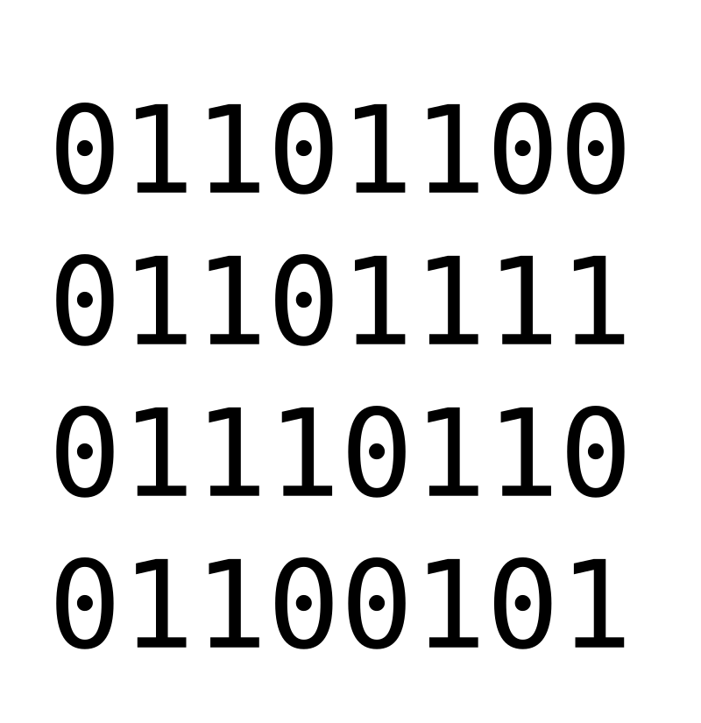




RTB Algorithms Pipeline
Train Data
ONLINE SPEC
ONLINE MONITORING
JAR
ONLINE JAR
JAR
OFFLINE JAR
JAR
PricingAPI

Slide 14
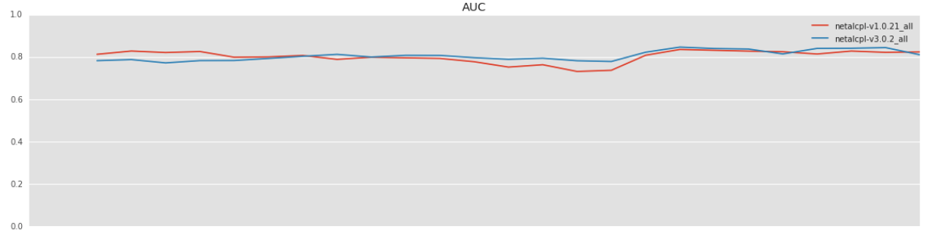
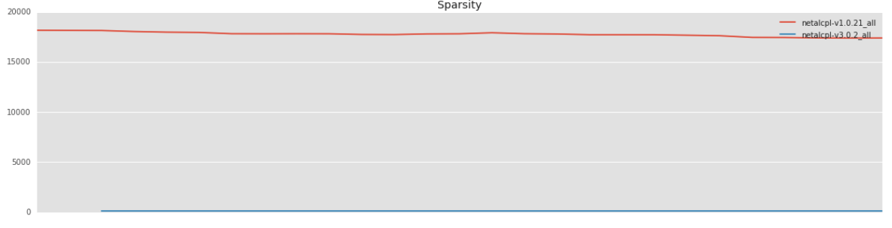
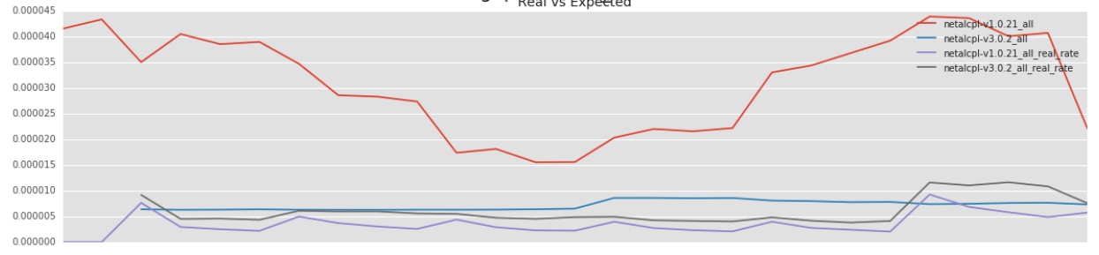
Backtests
AUC
Offline procedure to check performance of two competing models in time
Sequential analysis of historical data:
Data divided into training and test sets
Time series analysis of critical performance KPIs:
AUC
Sparsity
Target rates
If the backtests succeed the algorithm is submitted to online A/B testing procedure
SPARSITY
Target rate
Time

Slide 15
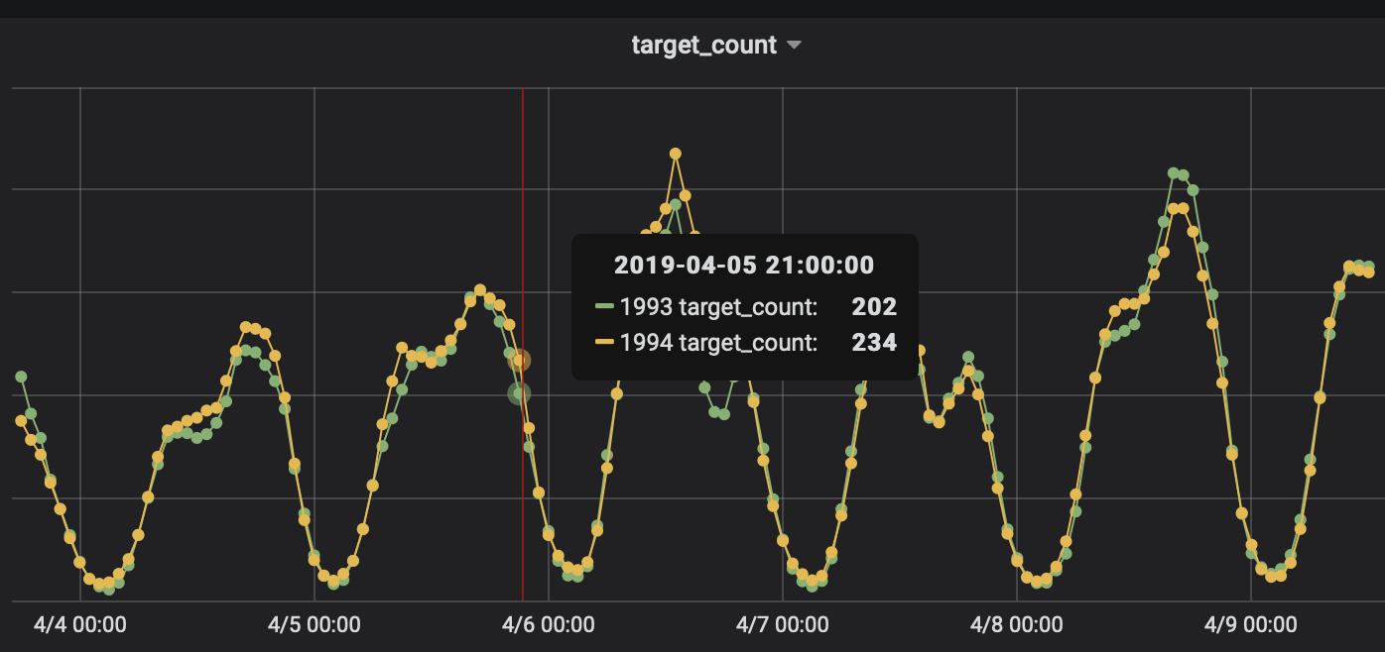
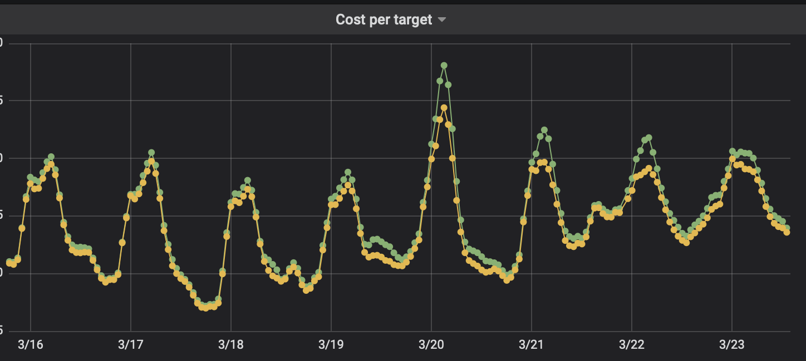
A/B test online monitoring
Split traffic to hash(cookie_id)%1024 buckets
For each experiment monitor
Cost per target
Target rate
Target count
Number of impressions
... many more

Slide 17
Bid Landscape

Slide 18
User Stories
As a Trafficker I want to know volume of impressions my campaign would win in RTB given the selected inventory, targeting and budget settings (CPM).
As a DSP I want to enable Advertisers winning impressions for lowest possible price.
Bid Shading
Demand Side Platform protects Advertiser from overpaying while AdTech ecosystem migrating from second-price to first-price RTB auctions.

Slide 19
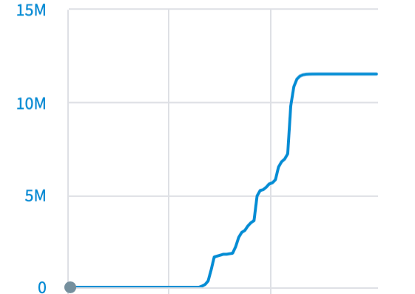
Forecasting & Bid Landscape
Forecasting
Total number of matching Bid Requests for given Campaign Targeting
Bid Opportunities
Bid Landscape
Predicting probability of winning auction with a given bid price and Campaign Settings
Win rate evolution with a bid price
Impressions
CPM

Slide 20
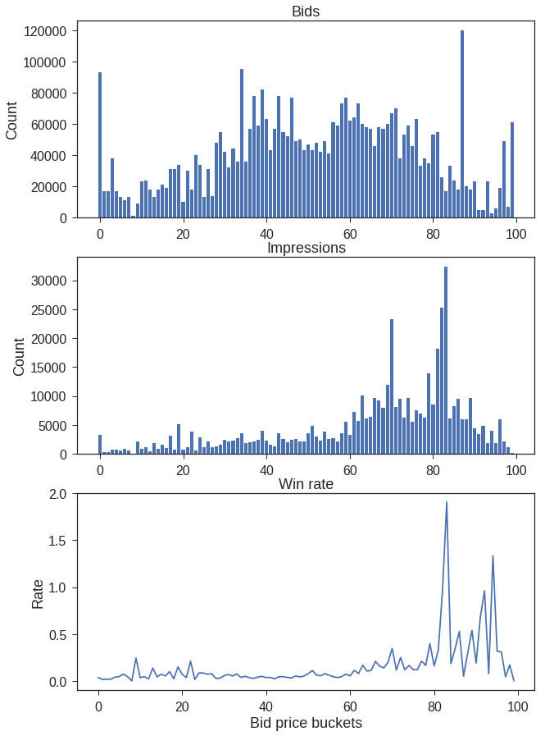
Bid Landscape
All Bids
Building Bid Landscape model using historical data regarding won and failed auctions:
For lost auctions win price is unknown
Right Censored Data
Survival Analysis
The exact moment of failure for majority of objects is unknown
Won Bids
Relative Rate
Bid Price Buckets

Slide 21
Population selection for Bid Landscape modelling

Slide 22
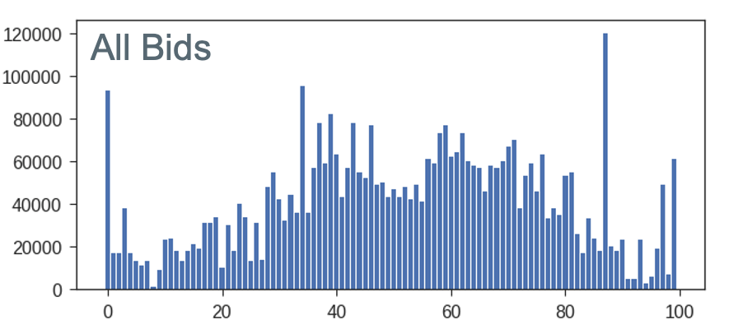

The Data
Input
Bids and Impressions with features
Impression is a Bid that won the auction
Output
cardinality of selected (Campaign Settings)
Bids bucketed by bid price
Impressions bucketed by bid price
Impressions bucketed by win price
100 buckets in our case
How?
Population Selection – select relevant population from high-dimensional space for survival analysis.
100000 | 2000 | 5000 | 100 | 4000 | 3000 | ... | 4500
source:biretail.com

Slide 23
Bitmaps (bitset, bitvector)
Matchingbids
0
0
0
0
1
0
0
1
…
0
Counts
Bid
0
1
2
3
4
5
6
7
…
100mln
iOS
0
0
1
0
1
1
0
1
…
0
waw
1
0
0
0
1
0
0
1
…
0
11:00
1
1
0
0
1
0
0
1
…
0
Bid Price Buckets
9900
790
2000
….
100

Slide 24

Nested queries on millions of features
AND, OR, NOT, XOR
Matchingbids
0
0
0
0
1
0
0
1
…
0
Counts
Bid
0
1
2
3
4
5
6
7
…
100mln
iOS
0
0
1
0
1
1
0
1
…
0
waw
1
0
0
0
1
0
0
1
…
0
11:00
1
1
0
0
1
0
0
1
…
0
3 mln other features
Bid Price Buckets
9900
790
2000
….
100

Slide 25
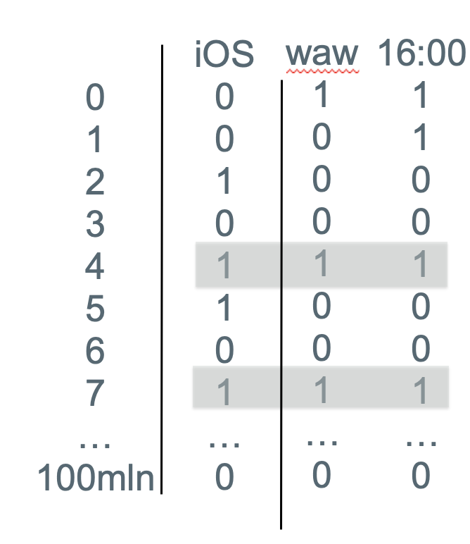
Buckets' cardinality
Bids
10000 | 3000 | ... | 4500
Survival
Analysis
Impr. Win Price
2000 | 100 | ... | 0
Impr. Bid Price
1000 | 800 | ... | 400

Slide 26
Roaring Bitmap
Roaring Bitmap – state of the art compressed bitmap algorithm.
Hybrid approach between sparse and dense bitmaps representation.
roaringbitmap.org/about/
„Use Roaring for bitmap compression whenever possible. Do not use other bitmap compression methods” [1]
[1] Wang, Jianguo, et al. "An experimental study of bitmap compression vs. inverted list compression." 2017.
[1] Wang, Jianguo, et al. "An experimental study of bitmap compression vs. inverted list compression." 2017.
[1] Wang, Jianguo, et al. "An experimental study of bitmap compression vs. inverted list compression." 2017.

Slide 27
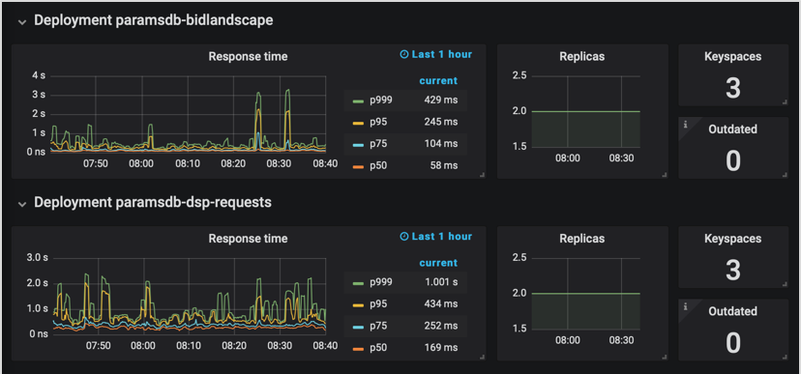
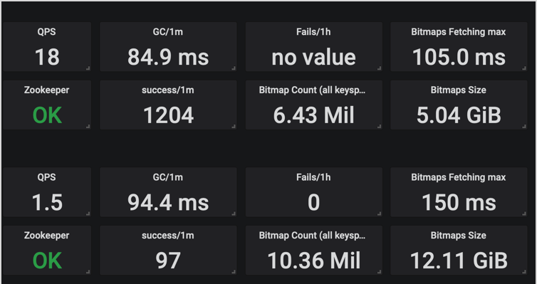
Bitmap Execution Database
Roaring Bitmap – state of the art compressed bitmap algorithm
Whole 7 days of Internet bid opportunities – 12GB (sample 1/1000) Naive 50TB
Bids&Impressions – 5GB (sample 1/100)
Majority of responses under 1 second

Slide 28
Nested set operations language
And(
Or("inventory|1", "inventory|2", "inventory|3"),
AndNot(
Universe,
Or("category|moto", "category|fishing")
),
Or(
"hour_of_week|41",
"hour_of_week|42",
"hour_of_week|43",
"hour_of_week|44"
),
Or("tld|com", "website|example.com"),
And(
"country|poland",
AndNot(
Universe,
"city|warsaw"
)
),
...
)

Slide 29
Survival analysis

Slide 30

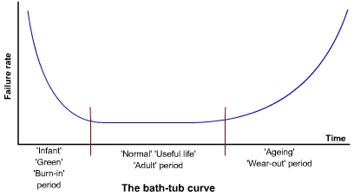
Principles of survival analysis
The basic assumption in survival analysis is that the risk of failure changes with time
Two major approaches for survival probability modelling can be distinguished:
Parametric – can be extrapolated for new experiences (Weibull)
Non-parametric – very flexible but can't be extended for new experience (Kaplan-Maier)
Failure Rate

Slide 31
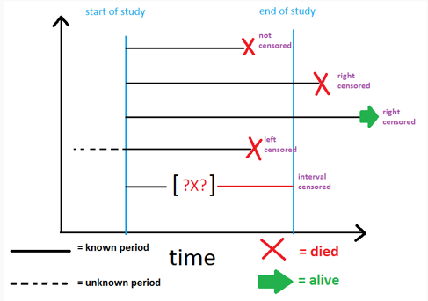
Data censoring in survival analysis

Slide 32
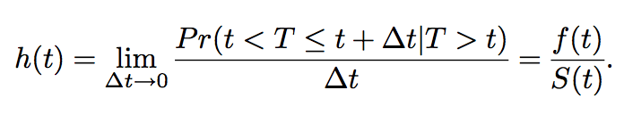
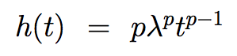
Weibull based survival probability estimation
Weibull distribution is derived from hazard function:
where:
S(t) - survival function (cdf)
F(t) = 1 – S(t) - failure function (cdf)
f(t) = dF(t)/dt - pdf
Weibull distribution is defined by 2 parameters:
Shape parameter p - failure mode type
Scale parameter λ - position
Survive .
Fail .
0
t
∆t
Time

Slide 33
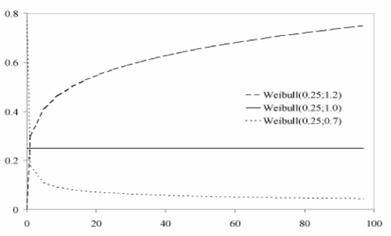
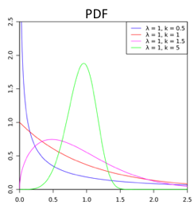
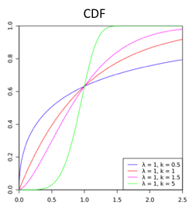
Weibull based survival probability estimation
One can distinguish 3 classes of failure types:
Infant mortality p < 1
Random failures p = 1
Ware out p > 1
Hazard
Weibull examples
age
Parametric approach easy to extrapolate

Slide 34
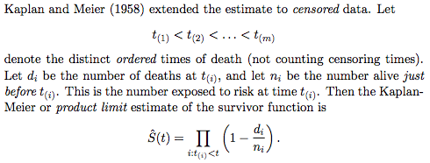
Kaplan-Maier based survival probability estimation
In Kaplan-Meier method we are to predict chance of surviving time ∆t after surviving time t:
Survive .
Survive.
S(t,Δt) = S(t) • S(Δt|t)
0
t
∆t
Time
No parameters to be estimated, very flexible and easy in implementation

Slide 35
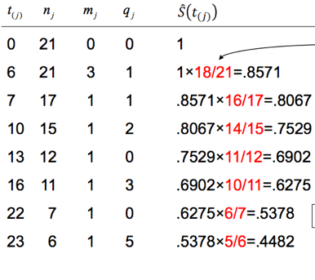
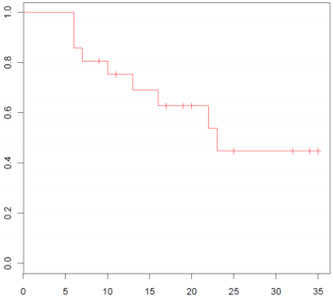
Kaplan-Meier curve calculation
S(t,Δt) = S(t) • S(Δt|t)
KM Curve for Group 1 (treatment)
Survival Probability
Time (weeks)

Slide 36
Elements of survival analysis in Bid Landscape modelling

Slide 37
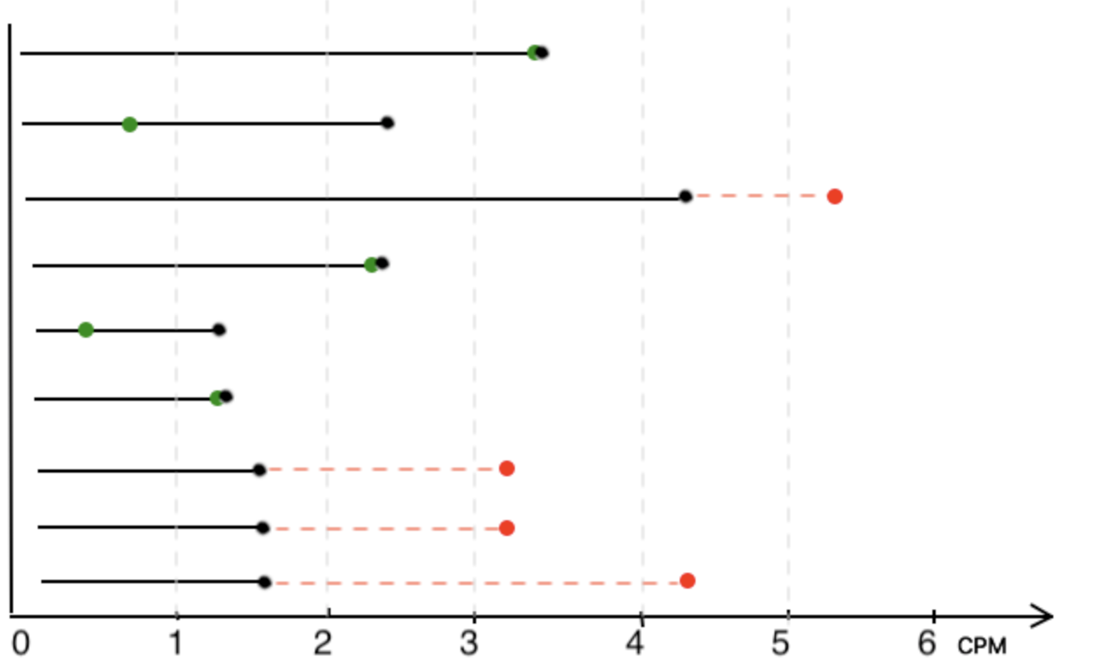
RTB auctions modelling with survival methods
From survival models to Bid Landscape:
time -> cost per 1k bought impressions (CPM)
died -> won bid (left censored, known win price)
alive -> lost bid (right censored, unknown exact win price)
our bid price
our win price (second price auction)
competitor outbid price (unknown)

Slide 38
Bid Landscape vs. Survival Analysis
Survival analysis
Risk of failure evolves with time
Incomplete knowledge regarding failure time, right censoring:
Majority of object survive
Multiple competing failure modes
Very high disproportion between positive (failures) and negative (survived) class representatives
Usually very limited data
Wrong predictions may have catastrophic consequences – quality monitoring required
Bid Landscape analysis
Winning probability evolves with price
Incomplete knowledge regarding win price, right censoring:
Only small fraction of bids are won
Different inventory sources
Very high disproportion between positive (won) and negative (lost) class representatives
Usually huge data sets – subsampling
Wrong predictions can lead to not efficient campaign money spend – quality monitoring required

Slide 39
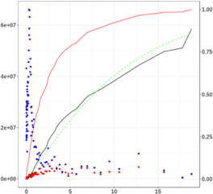
Survival model for Bid Landscape modelling
Let's apply survival techniques to auction data:
Instead of time a bid price is to be used
Legend:
• number of lost auctions
• number of won impressions
- win price CDF
- Kaplan-Maier estimate
- Weibull estimate
Multiplicity
Win Rate
Adform Bid Landscape exploits Kaplan-Maier estimate exclusively
Bid Price (CPM)

Slide 40
Bid Landscape validation in Adform

Slide 41
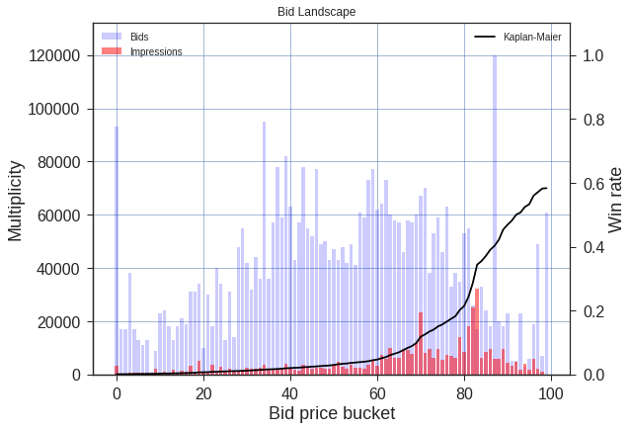
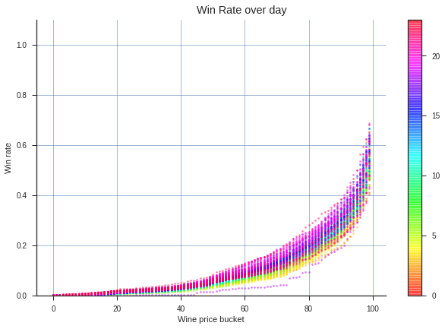
Bid Landscape validation – qualitative
Win rate evolution with bid price
Win rate evolution over day
The bid landscape predictions are in line with the intuition:
The win rate increases with bid price
The win rate changes periodically over a day

Slide 42
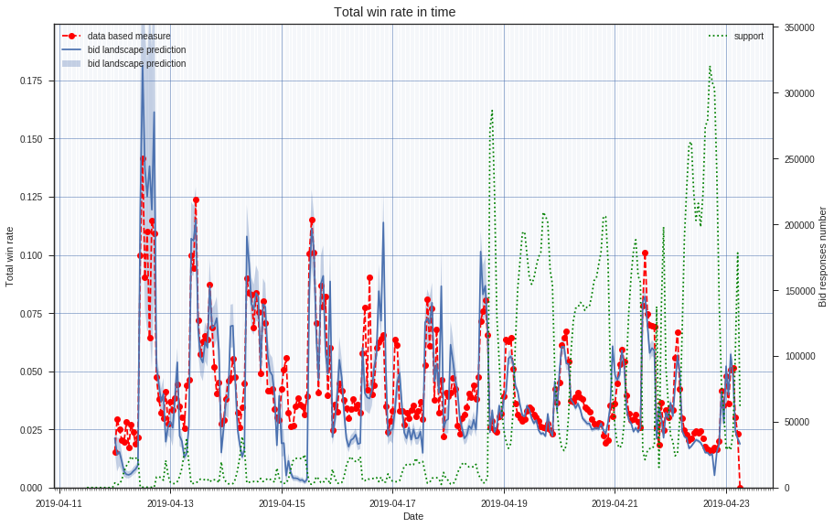
Bid Landscape validation – quantitative (real RTB data)
Real auction data versus Bid Landscape predictions

Slide 43
Bid Landscape as Adform product

Slide 44
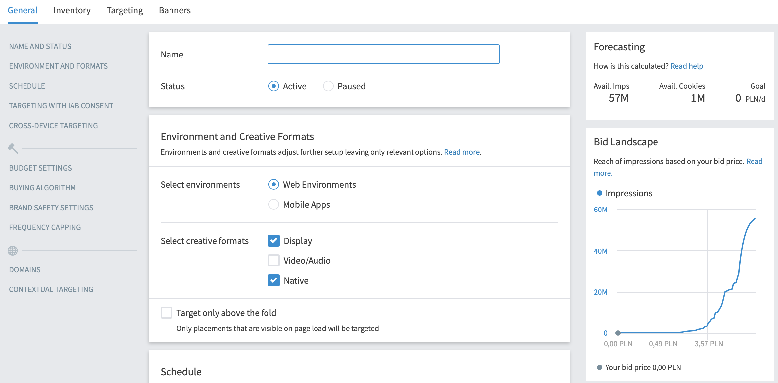
Interactive tool used in UI

Slide 45
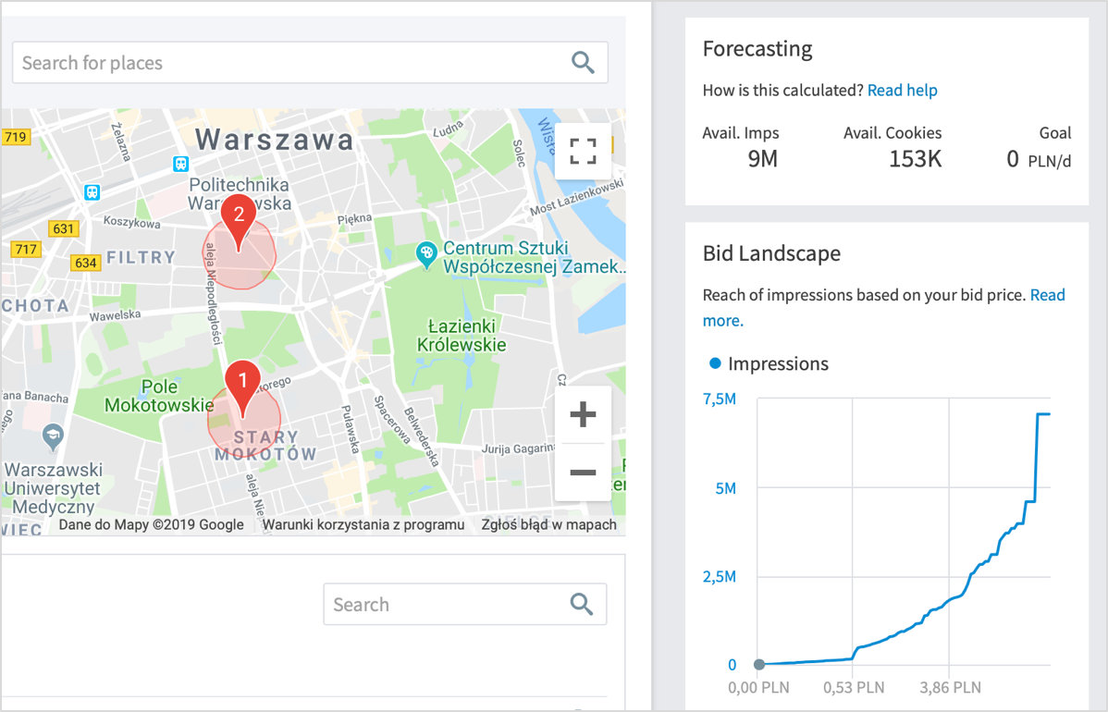
Hyperlocal precision

Slide 46
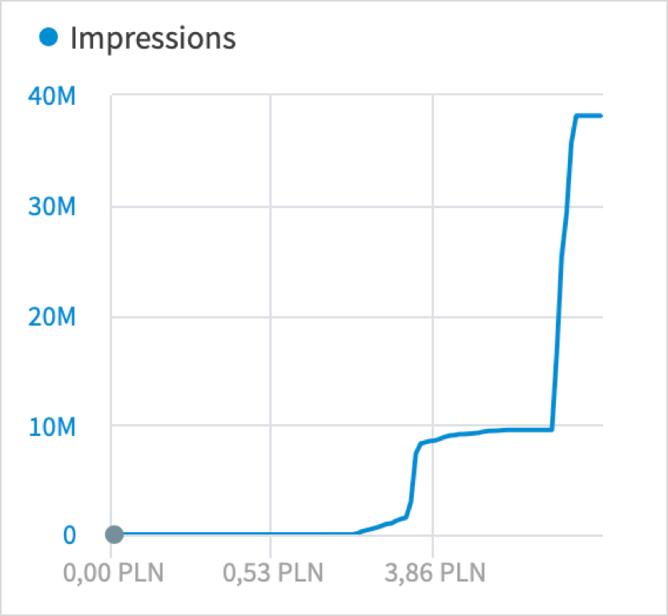
Floor Price detection

Slide 47
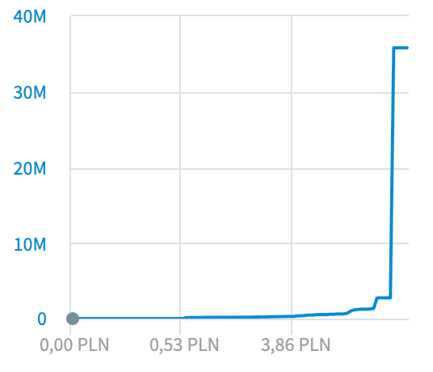
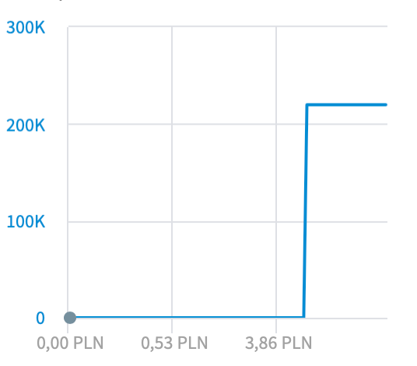
Bid Multipliers optimisation
Source of traffic:
Video oriented website
Campaign targeting Warsaw people to be run on three different domains
Global CPM makes no sense, needs to be adjusted
Impressions
Polish accountants' portal
Jobs for professionals

Slide 48
Bid Landscape dynamic CPM algorithm
Given the Campaign Settings including hourly budget maximize bought relevant impressions by using lowest CPM.
First tests are showing multiplied Viewable Impressions, Clicks comparing to same Campaign using static price.

Slide 49
Summary and conclusions
The Adform Bid Landscape is composed of two base elements ensuring speed and quality:
Bitmaps – fast and efficient population selection
Kaplan-Maier win rates – simple and precise estimate
The Adform Bid Landscape is in production for more than one year
It is mostly used by Adform customers optimising the CPM campaigns
Currently we develop new RTB algorithm that is based on BL predictions
In the short time perspective we are to extend usage of BL in other RTB models

